Slide 1
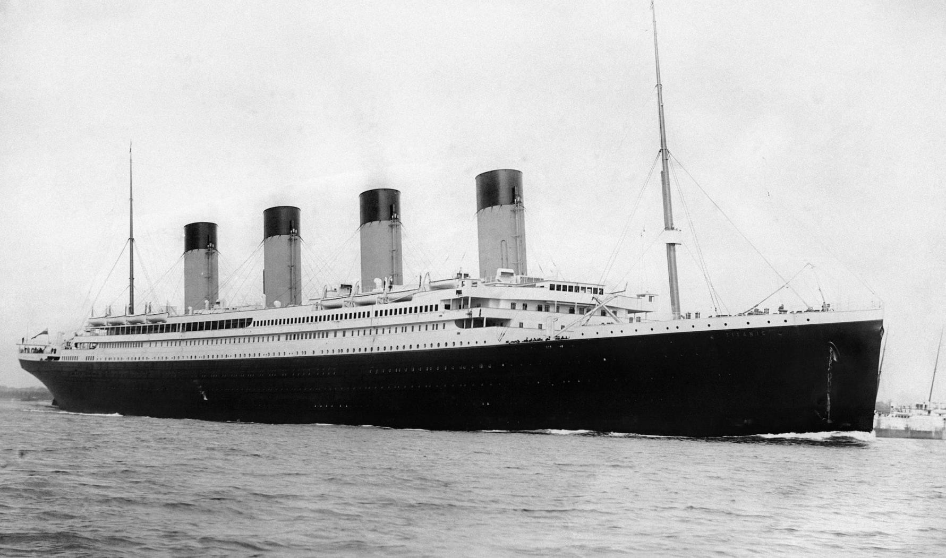
Submitted By- Guraziz Singh Bhatia
PREDICTING THE SURVIVAL OF TITANIC PASSENGERS
SUBMITTED BY- SHREYA SUMAN
Notes:
SHREYA SUMAN

Slide 2


TITANIC PROBLEM
 On April 15, 1912, during her maiden voyage, the Titanic sank after colliding with an iceberg, killing 1502 out of 2224 passengers and crew.
Translated 32% survival rate.
 One of the reasons that the shipwreck led to such loss of life was that there were not enough lifeboats for the passengers and crew.
 Although there was some element of luck involved in surviving the sinking, some groups of people were more likely to survive than others, such as women, children, and the upper-class.

Slide 3
AIM OF THE PROJECT
 To predict the number of surviving people from the disaster on basis of given dataset.
 To analyse various features which correlate to the surviving victims such as their Age, Sex, Fare they paid, etc.

Slide 4

REQUIREMENTS
SOFTWARE REQUIREMENTS
 •Jyupiter Notebook LIBRARIES USED
 Analysis : NumPy, Pandas, Scikit Learn
 Visualization: Matplotlib

Slide 5
STEPS FOR IMPLEMENTATION
 Importing the necessary Libraries
 Importing the Dataset
 Cleaning and analyzing the Dataset
 Converting necessary columns to numeric data
 Building the model
 Using different numbers of algorithms in classification techniques

Slide 6
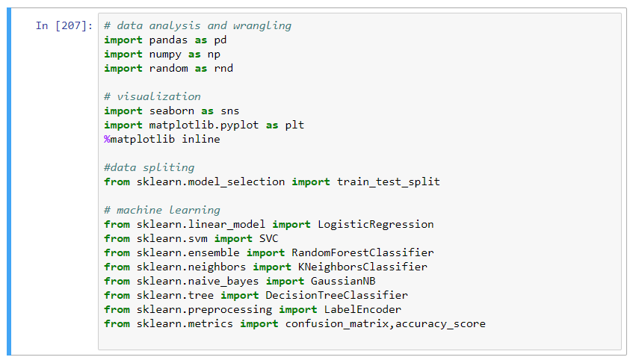
IMPORTING NECESSARY LIBRARIES

Slide 7
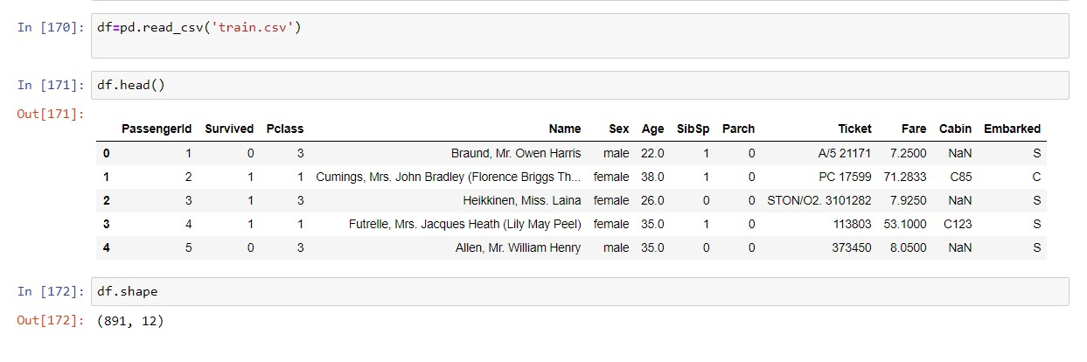
IMPORTING DATASET

Slide 8
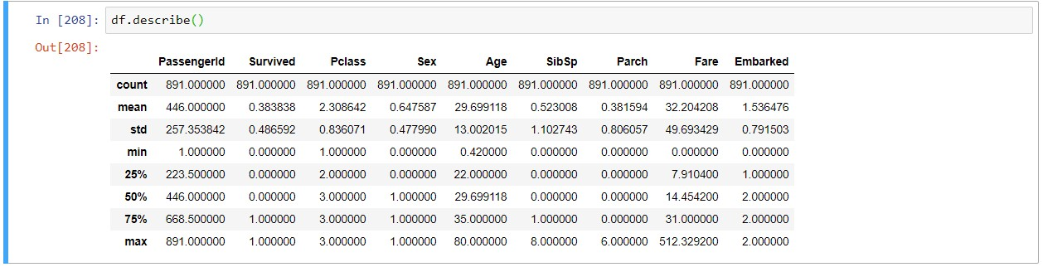
ANALYSING THE DATA BY DESCRIBING

Slide 9
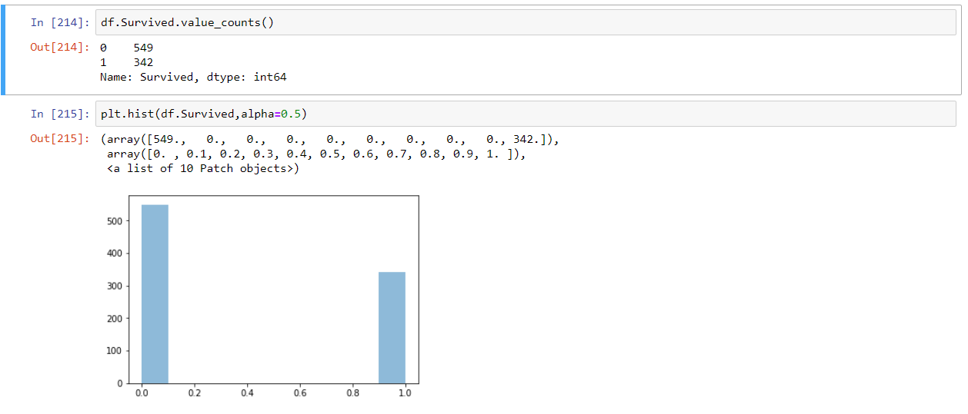
VISUALISING THE TARGET COLUMN
Approx. 38% survived the disaster according to the dataset

Slide 10
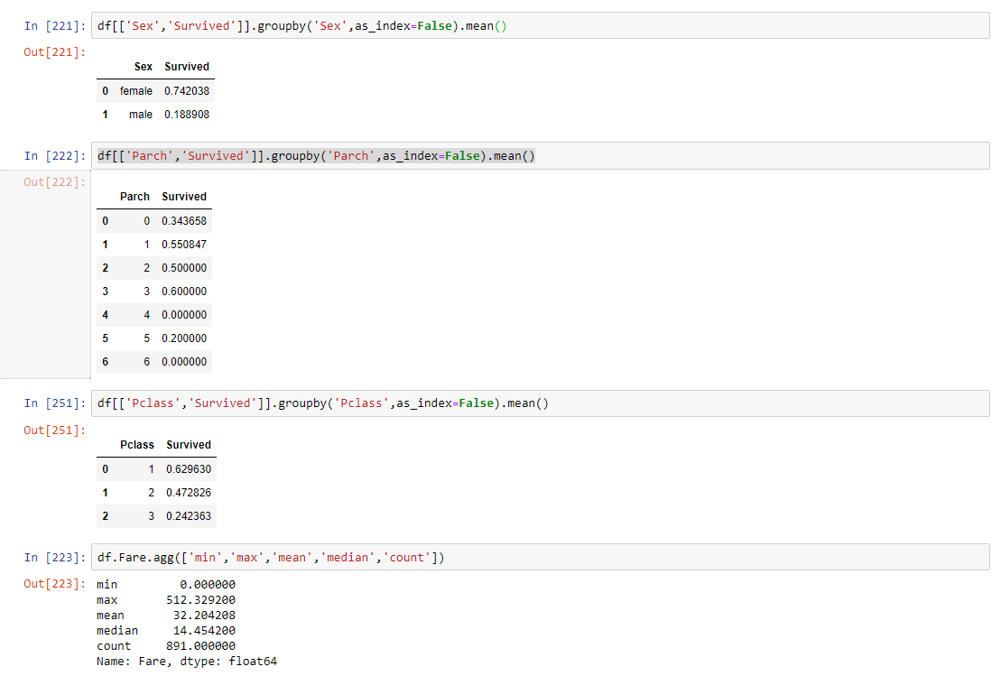
FINDING RELATION BETWEEN TARGET COLUMN AND OTHER FEATURES
 Sex, Pclass, Parch, Fare

Slide 11
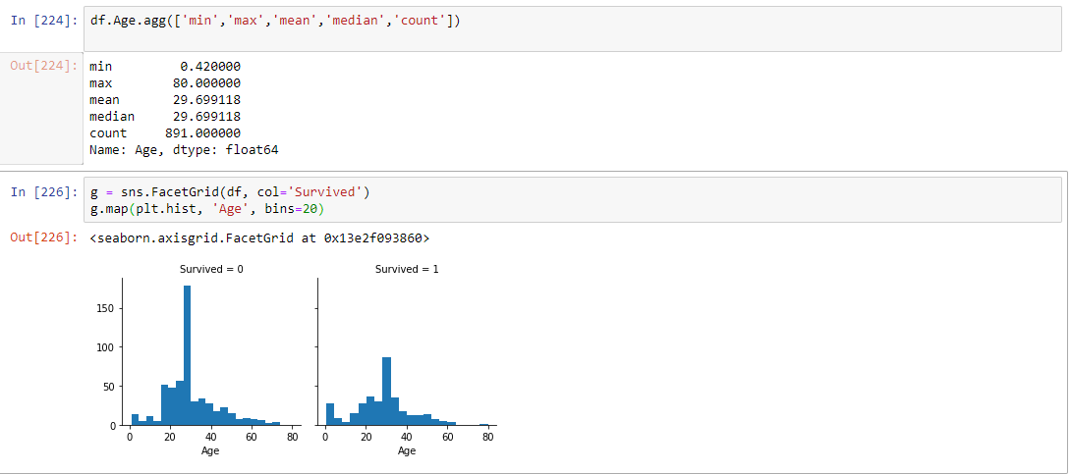
 Age
You can see that men have a high probability of survival when they are between 18 and 30 years old.

Slide 12
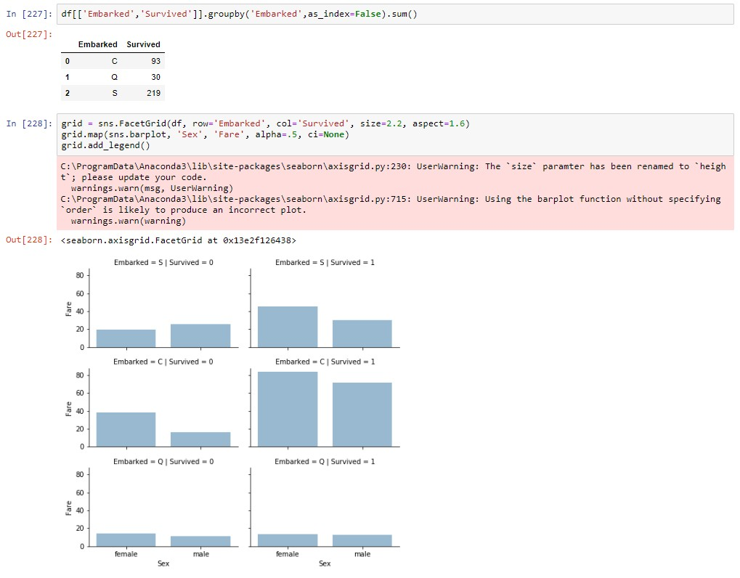
 Embarked

Slide 13


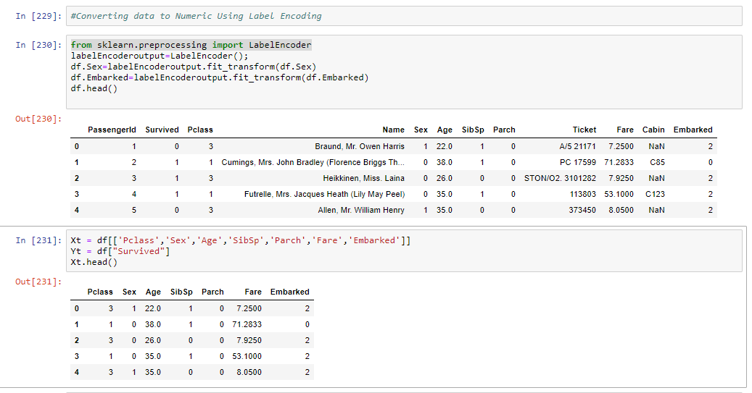
ENCODING DATA TO NUMERIC (FEATURE SCALING)

Slide 14
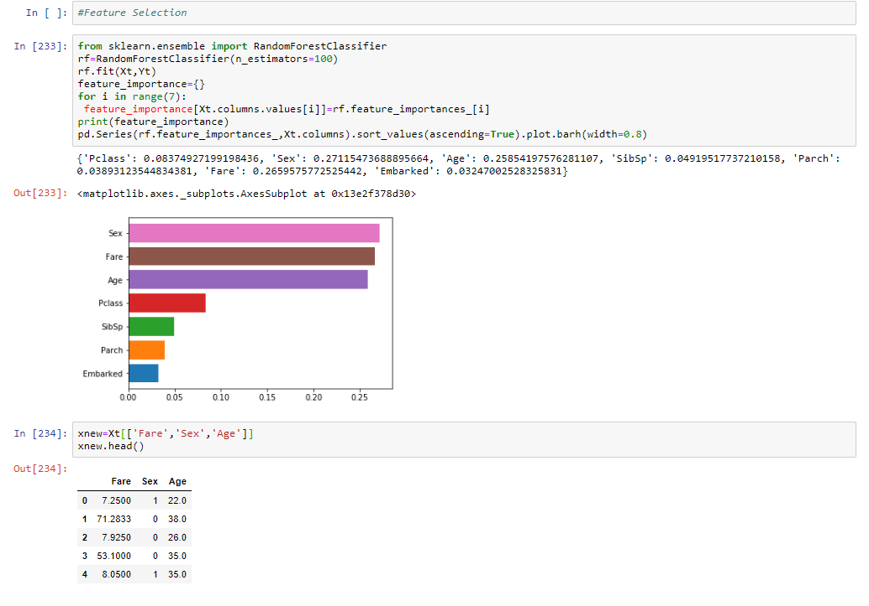
FEATURE SELECTION

Slide 15

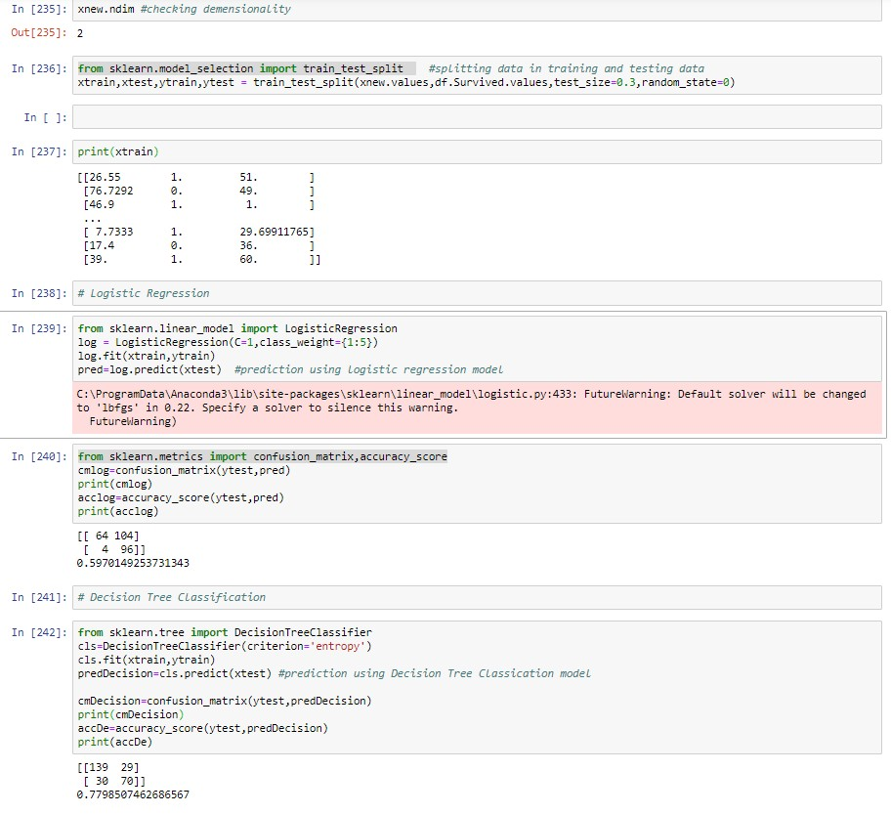
BUILDING MODEL AND CALCULATING PREDICTIONS

Slide 16
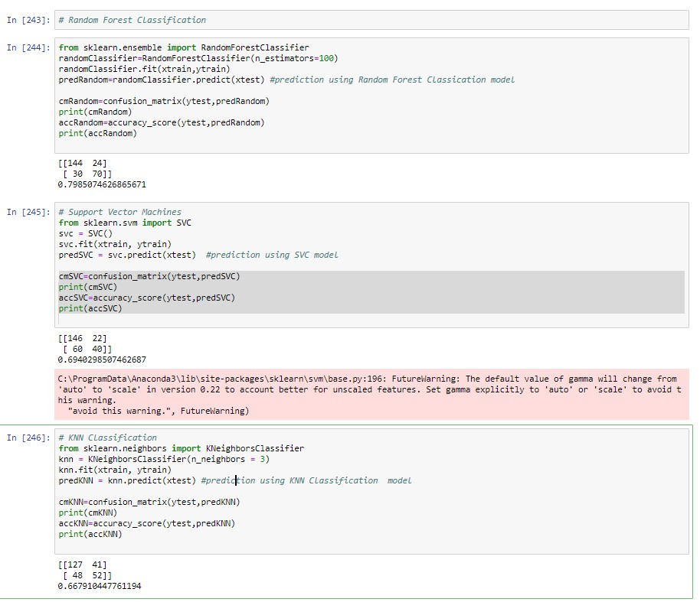

Slide 17
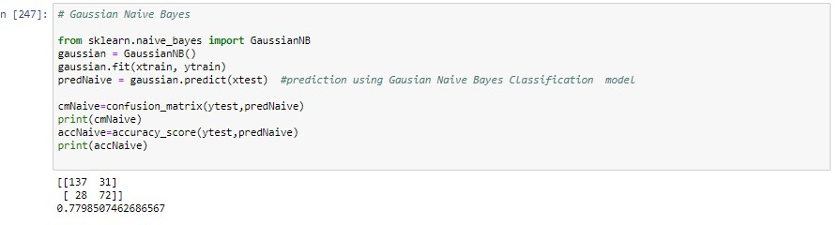

Slide 18
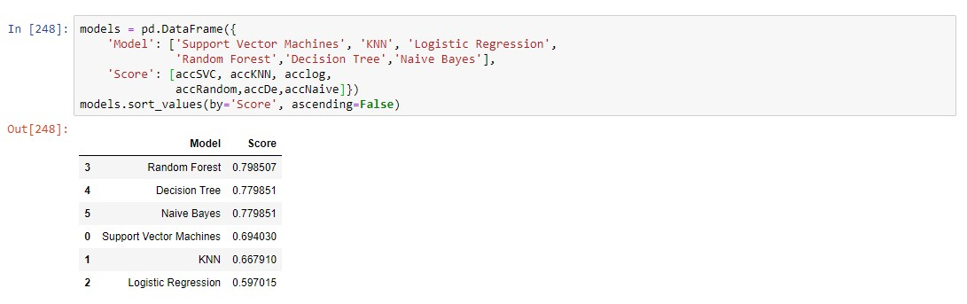
MAPPING PREDICTIONS AND ANALYSING

Slide 19

CONCLUSION
 We can conclude that Random forest classification model gives us best prediction of
79.85 %or 80% approx, whereas naïve bayes
and decision tree classification models have same prediction accuracy and less than random forrest.
 Here prediction is made on the features fare
,sex and age wrt to survived which are derived from feature selection.

